Slide 2
Welcome to Bible Survey!! – Class #1 ☺

Slide 3
Dr. Ilene Olsen

Slide 4
Let's get to know each other
In about 1 minute tell us:
Name
Country
Favorite Bible verse
What church do you serve in/Position
Why are you going to school?/trimester
Favorite food

Slide 5
About the class
Spiritual Approach
Educational Approach
Power Points
Results

Slide 6
Let's get to know about the class
Syllabus

Slide 9
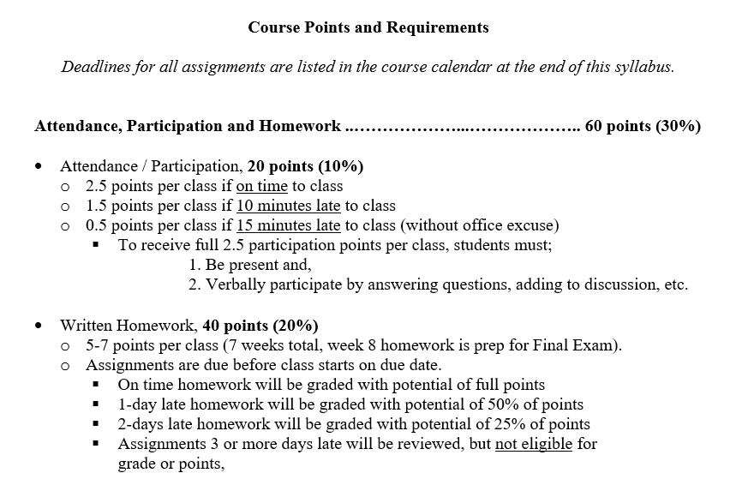

Slide 10
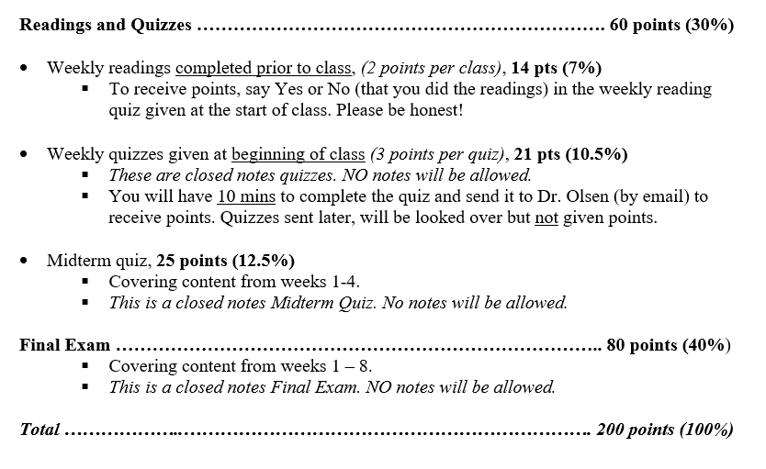

Slide 11
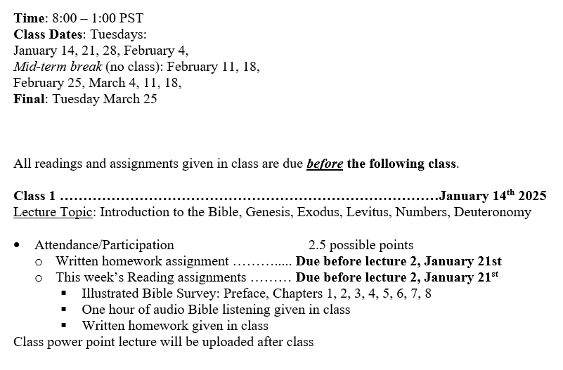

Slide 12
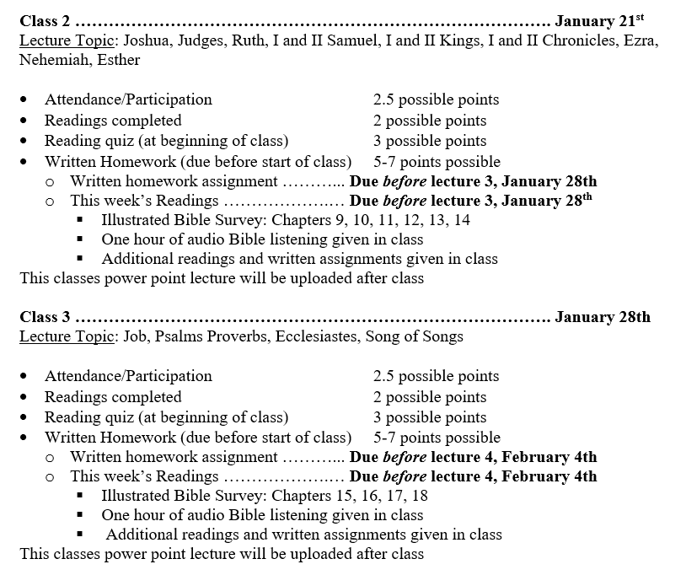

Slide 13
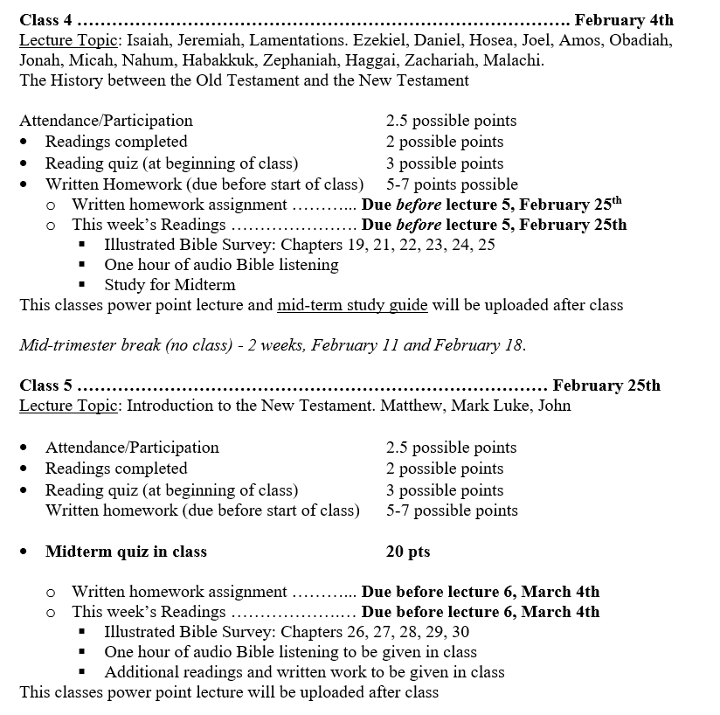

Slide 14
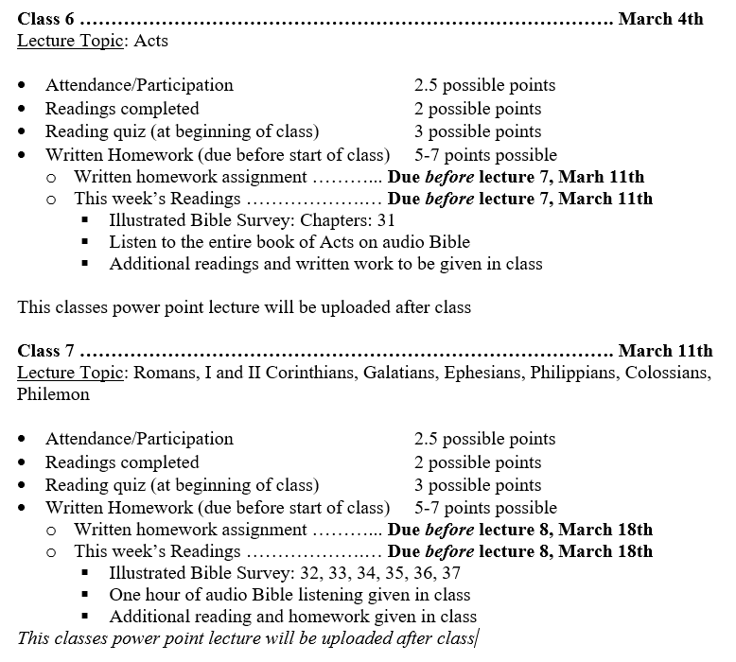

Slide 15
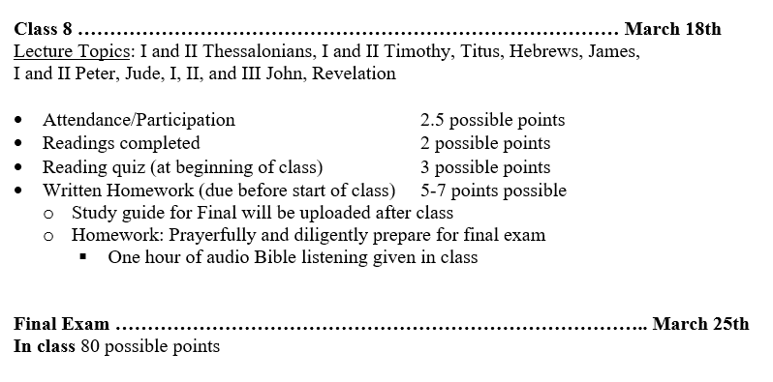

Slide 16
Today’s Class Agenda
Introduction to the Bible
10 minute break
Genesis
Exodus
30 minute break
Leviticus
Numbers
Deuteronomy
10 minute break
Discussion
Homework
Blessing

Slide 17
Trimester Objectives
Determine to grow in our faith

Slide 18
Trimester Objectives
Determine to grow in our faith
Embrace the direction God wants for our future

Slide 19
Trimester Objectives
Determine to grow in our faith
Embrace the direction God wants for our future
Learn more about scripture and how to apply it to ourselves and to those we serve

Slide 20
Trimester Objectives
Determine to grow in our faith
Embrace the direction God wants for our future
Learn more about scripture and how to apply it to ourselves and to those we serve
Seek his presence.

Slide 21
Trimester Objectives
Determine to grow in our faith
Embrace the direction God wants for our future
Learn more about scripture and how to apply it to ourselves and to those we serve
Seek his presence.
Remember, God wants us to come to the Holy of Holy's and really get to know him!

Slide 22
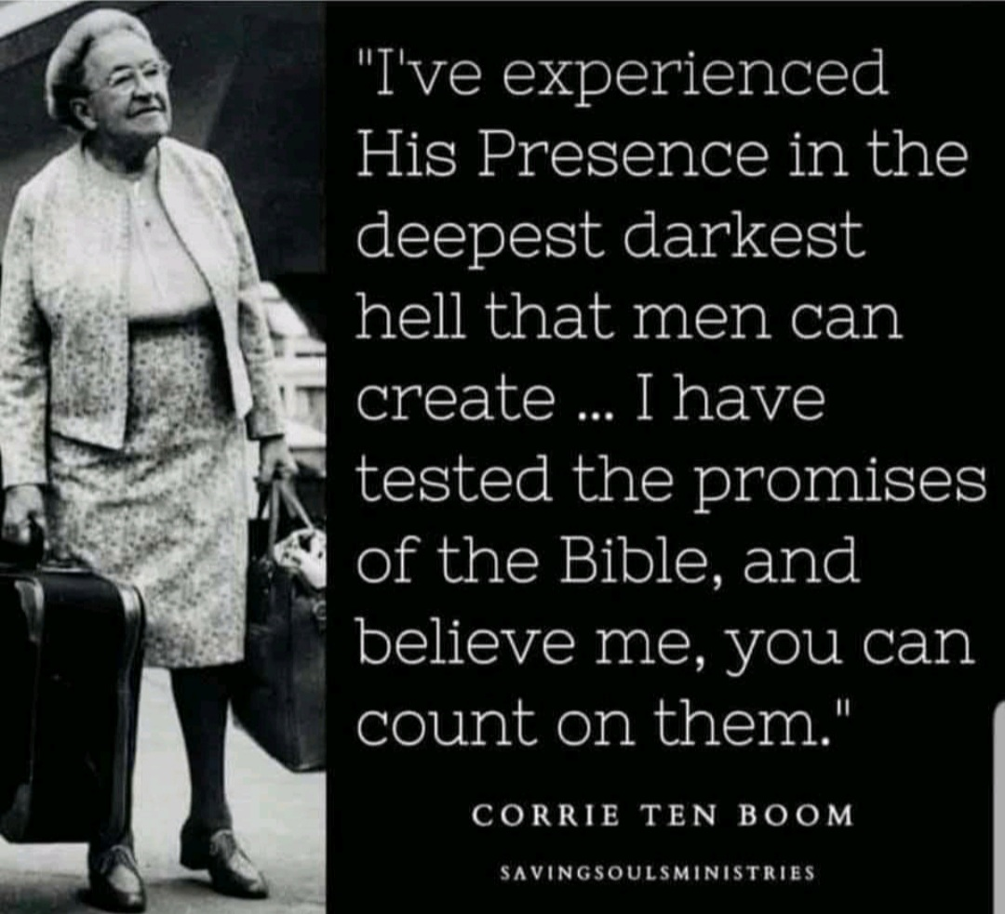
The Bible gives us God’s promises for life
The Bible is practical

Slide 23
The Bible
The Bible is the living Word of God.
The Bible still speaks to the minds, heats, and souls of men and women today.
The Bible confronts us of sin, exposes our selfishness and pride, examines our motives, challenges our culture, and calls us to true repentance.
The Bible asks us to believe every word, stretches our faith, heals our hurts, encourages our hearts, gives us peace, and soothes our souls.
The most influential book ever written
The Bible is The Word of God
The Bible is
Authoritative for every situation,
In every language
For every person
Throughout all time

Slide 24
The Bible is
The most influential book ever written
The Word of God
Authoritative for every situation,
In every language
For every person
Throughout all time

Slide 25
Studying the Bible
All scripture is God-breathed, and is useful for teaching, rebuking, correcting and training in righteousness.
II Timothy 3:16 NIV
Jesus quoted the Bible as
The Word of God with confidence.
The Bible is a collection of 66 books
Old Testament - 39 Books
New Testament - 27 Books
The Bible is the best-selling book in the world!

Slide 26
The Bible shows us who God is
Living
Powerful
Encourages
Confronts us of sin
Examines our motives
Calls us to repentance
Ask us to believe God's incredible miracles
Stretches our faith
Heals our hurts

Slide 27
The Canon
All the books of the Bible that are recognized as divinely inspired
and authoritative for faith and practice
Canon Hebrew - Qaneh, Greek - Kanon.
Reed or a measuring stick.
A standard by which a book is measured.
The books of the Bible are not inspired because people gave them conical status.
The books of the Bible were recognized as conical, because they were inspired by God.
“The books of the Old Testament did not receive their authority because they were placed in the canon. They were recognized by Israel as having divine authority and were therefore included in the canon”. Wagner

Slide 28
The Old Testament
God revealed his word to Israel over a 1000 years period, from 1400 to 400 BC.
The 4 major sections of the Old Testament
1. The Pentateuch
Genesis - Deuteronomy

Slide 29
The Old Testament
God revealed his word to Israel over a 1000 years period, from 1400 to 400 BC.
The 4 major sections of the Old Testament
1. The Pentateuch
Genesis - Deuteronomy
2. History
Joshua - Esther

Slide 30
The Old Testament
God revealed his word to Israel over a 1000 years period, from 1400 to 400 BC.
The 4 major sections of the Old Testament
1. The Pentateuch
Genesis - Deuteronomy
2. History
Joshua - Esther
3. Poetry
Job- Song of Songs (Song of Solomon)

Slide 31
The Old Testament
God revealed his word to Israel over a 1000 years period, from 1400 to 400 BC.
The 4 major sections of the Old Testament
1. The Pentateuch
Genesis - Deuteronomy
2. History
Joshua - Esther
3. Poetry
Job- Song of Songs (Song of Solomon)
4. The major and minor prophets
Isaiah – Malachi

Slide 32
The Old Testament
God revealed his word to Israel over a 1000 years period, from 1400 to 400 BC.
The 4 major sections of the Old Testament
1. The Pentateuch
Genesis - Deuteronomy
2. History
Joshua - Esther
3. Poetry
Job- Song of Song (Song of Solomon)
4. The major and minor prophets
Isaiah – Malachi

Slide 33
Preservation of the Old Testament
After the close of the Old Testament Canon, in about 300 BC, the copying of the Old Testament was careful and meticulous.
Clothes
Narrow way – broad way
The Masorete scribes (AD 500-1000) meticulously counted the letters and words in the verses in every text.
No other documents from the ancient world has ever been as accurately copied, preserved and transmitted as the Old Testament scriptures.

Slide 34
How to study the Bible
6 steps
What questions to ask

Slide 35
Step 1:
What is God saying or showing me.
His character/ nature
Example in the past- same, yesterday, today and forever
Promises/reassurance

Slide 36
Step 2:
What is the background?
To whom was this written?
Time period
Culture
Place/setting (dry desert, ocean …)

Slide 37
Step 3:
Why did the author write this?
Instruct/example
Encourage
Remind
Answer a question – in the New Testament, some letters are written as answers to previously asked questions (we may not know what the questions was.)

Slide 38
Step 4:
Be respectful of the context.
Read the entire passage through.
Do not pick and choose scriptures to prove your point.
Never try and force scripture to prove your point.
Scripture stands on its own.
Read scripture through a biblical worldview, not your own
Some have latched onto one phrase

Slide 39
Step 5:
Study
Since God has inspired every word in scripture
II Timothy 2:15 tells us to Study to show yourself approved unto God, a workman that does not need to be ashamed, rightly dividing the word of truth.
We are commanded to study carefully
The Bible does not contradict itself.

Slide 40
Step 6:
Apply
How should I apply this scripture practically to my own life?
Be able to discern and apply the difference between applying scripture to your own life, and studying in order to serve those God has given me to care for.

Slide 41
The Pentateuch

Slide 42
The Pentateuch
First 5 books of the Bible
Genesis
Exodus
Leviticus
Numbers
Deuteronomy

Slide 43
10 Minute Break

Slide 44
Genesis
Author: Moses
Recipients: Israelites
Date: 1445 BC
Key word: Create (Hebrew Hb, bara)
Key verse: “In the beginning God created the heaven and the earth” (1:1)
The Hebrew Bible titles this first book bereshith (“in the beginning”)
the first word in the Hebrew text

Slide 45
Genesis
Gives us a picture of God who he is, his character and his Power
Lays the foundation for all the biblical theology throughout the entire Old and New Testament
Foundational for all the promises to those who believe in Him today

Slide 46
Foundation for Biblical Worldview
The early chapters of Genesis lay a foundation for the biblical worldview
God is all powerful and all knowing – He has no equal
God is loving, kind and just
God can be approached and personally known
God is eternal
The world is God’s creation
Human beings are created in the image of God
God is a unique personal being who is distinct from his creation
Humans are clearly distinct from animals. Only men and women, humans, have the capacity to know God personally
Our fallen sin nature causes us to run from God rather than to run to God
God intervenes in human history and reveals himself to us so we might know him again

Slide 47
Chapters: 1-2, creation
In the beginning, God
Assumes the existence of God – Elohim (Hebrew)
Creation was instantaneous
Completely transcends all the primitive mythology of the ancient world.
Shows the power of God’s spoken word. What happens when God speaks?
From nothing - ex nihilo (Hebrew)
Covers more time than any other biblical book

Slide 48
Chapters: 3-5, fall Adam and Eve sinned
Chapters: 6-9, flood
Chapters: 10-11, tower of babel
Chapters: 10-36, history of Abraham (father of multitudes)
and Sarah (princess)
Chapters: 25-26, Isaac
Chapters: 27-36, Jacob
Chapters: 37-50, Joseph

Slide 49
Worldview The lens through which we see life. It dictates belief in what is true, meaningful, honorable, valuable, eternal

Slide 50
Biblical Worldview
God is the source of all truth.
The Bible is the authoritative word of God it speaks to every area of my life
I need to continue to study, understand apply its truth to my life
I want my lifestyle, time, finances, affection all to be under God’s control
Continue to desire the Bible to change me and my worldview
I need to be aware - not to read my own culture back into the Bible

Slide 51
Participation
Question:
What problems and sin do you see in your church today, because part of their worldview is apposed to scriptural worldview?

Slide 52
Exodus
Author: Moses
Recipients: Israelites
Key Word: Passover
Key Verse: God replied to Moses, “I Am, who I Am.” Exodus. 3:14
First person form of the Hebrew verb, HAYAH – to be –The self existent one
Focus: The first 2/3 of The life of Moses, 80 years.
The first 40 years from birth to becoming a Prince in Egypt,
The second 40 years in Midian as a shepherd.
Question: Are names and titles important?

Slide 53
Time-line of Exodus
Overarching Story: God's love for his people
Slavery and liberation
The exit from Egypt
The call of Moses
The confrontation with pharaoh
The dramatic events of the exodus
Israel's arrival to mount Sinai

Slide 54
Practical Applications in Exodus
God…
Is not an aloof, inactive or far away God.
Sees, hears, observes, is involved, is concerned
Cares about the struggles of his people.
Is the all-powerful God.
Question:
How does knowing about God, as a follower of Jesus, effect how we view ourselves and others?

Slide 55
The 10 Commandments

Slide 56
Exodus 20: 1-17
Commandments 1 - 4 individual relationships to God.
1. No other gods
2. Do not make an idol
3. Do not misuse God's name
Language – powerful. Omitting ideas, adding Daniel 3:28-29
4. Remember the Sabbath

Slide 57
Commandments 5-10 individuals relate to each other, community.
5. Honor your mother and father
6. Do not murder
7. Do not commit adultery
8. Do not steal
9. No false testimony
10. Do not covet

Slide 58
The Tabernacle
The tabernacle or tent of meeting
Built to exact specifications
Represented where God would live with his people.
The ark of the covenant and the mercy seat represented his presence.
The lampstand represented his guidance.
The veil represented the barrier between Holy God and sinful man.
The bronze altar where the animal sacrifices were offered showed that people could only come to the holy God through sacrifice not through works.

Slide 59
When Jesus died on the cross the veil of the temple was torn from top to bottom exposing the holies of holies Matthew 27:51.
Jesus became the ultimate sacrifice for our sins and through his blood we have access to the very presence of God
We are encouraged to draw near to God
Hebrews 4:15- 16
Hebrews 10:19 - 22.

Slide 60
Hebrews 4:15- 16
For since we have a high priest who has gone through the heavens, Jesus the son of God, let us hold firmly to the faith we profess. For we do not have a high priest who is unable to sympathize with our weakness, but we have one who has been tempted in every way, just as we are - yet was without sin. Let us then approach the throne of grace with confidence, so that we may receive mercy and find grace to help us in our time of need,

Slide 61
Hebrews 10:19 - 24.
Therefore, brothers, since we have confidence to enter the Most Holy Place by the blood of Jesus, by a new and living way opened for us through the curtain, that is, his body, and since we have a great priest over the house of God, let us draw near to God with a sincere heart in full assurance of faith, having our hearts sprinkled to cleanse us from a guilty conscience and having our bodies washed with pure water. Let us hold unswervingly to the hope we profess, for he who promised is faithful. And let us consider how we may spur one another on toward love and good deeds.
Story - Bird-in-hand Pennsylvania

Slide 62
30 Minute Break

Slide 63
Leviticus
Author: Moses
Recipients: Israel at Mt. Sinai
Date: 1445 BC
Major theme: God is holy, Holiness (Hebrew qodesh)
Key Verse: Be holy for I am holy. Leviticus 11: 44 and 45
Purpose: A worship guide for both priests and people
Purpose: To teach Israel how to walk in practical holiness with God
Big Idea: God is an ever present, personal, holy God, who demands holiness.

Slide 64
New Testament View of Holiness
Romans 12:1 Therefore I urge you, brothers, in view of God’s mercy, to offer your bodies as living sacrifices, holy and pleasing to God – this is your spiritual act of worship.

Slide 65
New Testament View of Holiness
Romans 12:1 Therefore I urge you, brothers, in view of God’s mercy, to offer your bodies as living sacrifices, holy and pleasing to God – this is your spiritual act of worship.
I John 1:7 But if we walk in the light ,we have fellowship with one another, and the blood of Jesus, His son, purifies us from all sin.

Slide 66
Numbers
Author: Moses
Recipients: The second generation of Israelites in the wilderness
Date: 1444-1406 BC
Key Verse: Numbers 6:22-26
Big Idea: success and ultimate failure of the first generation.
Unbelief, disobedience, ungratefulness, and grumbling against God and Gods leader Moses, disqualified the first generation from going into the promised land.
The unbelief and disobedience of the first generation was so pervasive that even Moses own brother and sister revolted against66 him.

Slide 67
Miriam and Aaron's objection were motivated by jealousy and prejudice. Moses' wife was a Cushite, of African descent. It is clear that God defended Moses' decision and was not pleased with their attitude.
Miriam's leprosy, extreme whiteness, was the opposite of the complexion of Moses wife.
Moses prayed for his sister and God healed her.
(Moses knew what leprosy felt like)

Slide 68
God's covenant and promise to Israel was spiritual not racial.
Isaac married Rebecca an Armenian.
Judah fathered twins by Tamar a Canaanite.
Joseph married Asenath, an Egyptian.
All these women later became mothers of tribes of Israel.
The covenant with Abraham was spiritual not racial.

Slide 69
When the 10 spies returned with a negative report it was a turning point for the first generation.
Desire to return to Egypt
Rejection of what God had accomplished for them
Rejection of Moses as God's chosen leader
Out of the heart, the mouth speaks

Slide 70
The second half of the book of Numbers 26 – 30, shifts to the second generations hope for a better future.
The Lesson: God will bypass one generation if necessary and move on to the next generation.
The decrees:
Daughters with no surviving brothers had a right to inherit land from their fathers.
The first generation had been blessed but were disinherited because of their disobedience.
Must remain faithful so they could receive their inheritance in the promised land.
The new generation would accomplish what the first generation had failed to do.
Joshua as a new leader
I Corinthians 10:1-13

Slide 71
Review of Numbers (3 sermons)
Chapters 1- 4.
Encouraging the second generation to remember what God did for them.
Chapter 5-26
Emotional, he calls for Israel to love God with all their heart.
Reverence him
Serve him.
Explains the intent of the 10 commandments
It is inward motivation toward God.

Slide 72
Chapters 27 - 34
Prophetic
Moses encourages to remember the covenant and
To ratify again - the covenant the previous generation disobeyed.
Explains what God will do for Israel
Provides a final summary of the covenant.
It is his farewell address, his last will.
He concludes by talking about the transition of leadership to the next generation.

Slide 73
Deuteronomy
The final book in the Law, or Torah.
Author: Moses
Recipients: The new generation of Israelites.
Those who had been less than 20 years old when Moses first numbered the people
Date: 1406 BC
When: At the end of the wilderness wanderings
On the eve of the conquest of Canaan.
Just before Moses death
Where: The entire book occurred as the nation was encamped on the plains of Moab.

Slide 74
Key Word: Listen
Key idea: God gave the law to Israel to show them how to live in community based on righteousness.
Key verses: Listen Israel the Lord our God the Lord is one. love the Lord your God with all your heart with all your soul with all your strength Deuteronomy 6: 4-5
The Shema Prayer, Deuteronomy 6:4- 5. This is the core of Judaism today.
Hear, O Israel, the Lord our God, the Lord is one. Love the Lord your God with all your heart and with all your soul and with all your strength.
Big ideas: loving God totally
Teaching to one's children.
Choices have consequences

Slide 75
God gave the law to Israel to show them how to live in community based on righteousness.
It is not a matter of rules and regulations, but a response.
responding in spiritual devotion and love to the one true God.
In Matthew when Jesus was asked about the greatest commandment he quoted, Deuteronomy 6:4- 5.

Slide 76
Message: Moses reviewed God's past acts for Israel
Instructed them to honor the covenant
Explained what God would do for Israel if they obeyed.
Promised that God would bless or curse Israel based on their obedience or disobedience.
Reminds the second generation of his own disinheritance, he would not be allowed to go into the promised land because of his own sin.
He was a transparent leader.

Slide 77
10 Minute Break

Slide 78
Participation
Question:
As a leader today, how does Moses’ example show us how leaders should act and lead?

Slide 79
Homework
Complete All required reading
Students will create a prayer team of 2 to 3 people.
Choose people who you can depend on to pray for you, to share challenges with, and to meet with regularly.
1. Each student will present in class (2 minutes total)
a. How did you chose your prayer team? Who are they?
b. How will you design your time with the team?
c. What is the desired outcome for you and your team?
(Notes for the presentation to be submitted as part of homework prior to class.)
Questions 2 and 3 should be answered in one paragraph, 6 to 10 sentences.
2. In Deuteronomy, Moses reviewed the law for the new generation.
* Why was review important then?
* Why is it important for leaders today to continue to review and remember?
3. Holiness is a major theme in Leviticus.
* What does practical and personal holiness look like in your life today?

Slide 80
Next weeks Quiz
Know the first 5 books of the Bible in order
Be able to quote the key verse from Genesis (Genesis 1:1) In the beginning God created the heavens and the earth.
Be able to quote the key verse from Deuteronomy (Deuteronomy 6:4-5) Listen, Israel, the Lord our God, the Lord is one. Love the Lord your God with all your heart, with all your soul, and with all your strength.
Each student will be asked if they completely read (not skimmed) all the assigned reading.
Each student will be asked if they listened one hour to an audio Bible.

Slide 81
Blessing
May the Lord bless you and protect you.
May the Lord smile upon you and be gracious to you.
May the Lord show you his favor and give you his peace.
Numbers 6:22-26 NLT

