Slide 1
Feedback
How to get it and what to do with it

Slide 2
First, a story
“I think the world market has room for 5 computers, no more.” - Thomas J. Watson, chairman of IBM, 1943
“I see no reason why individuals should have their own computers.” - Ken Olsen, DEC’s chief executive officer, 1977
The lesson?
Even smart people can be completely out of touch with reality. What is missing?
Not asking questions OR not asking the right questions to the right people.

Slide 3
Okay, another story…
In the ‘80s and ‘90s there were 0 American manufacturers of fax machines when the most common office device in use was a fax machine. Why?
Focus Groups were asked:
“Would you buy a phone accessory for over $1,500 that allows you to mail letters that the post office delivers for $0.25 and pay $1 per page to use it?”
This is the right question but it is asked the wrong way!

Slide 4
How do we ask questions?
Surveys
Make them short and frequent
Normalize them (once a year or more, use the same questions and new questions to address new issues and compare to past surveys)
Use a Variety of Questions
Yes/No Questions
Rate from 1-10, 1 being good, 10 being bad
Open questions
Keep these brief, direct and simple
What would improve our children’s ministry?
NOT How is church?
What about groups? Only if they are smaller than 7 people.

Slide 5
What should you do with the results?
Share the results
Outline and demonstrate action steps
Be selective: What will you actually do? What was helpful feedback?
Thank the people who gave you this feedback
Work with your strengths not your weaknesses
Acknowledge weaknesses and do what you can but do not do more
Take something good and make it better
Make the data and the action steps available for people to see later

Slide 6
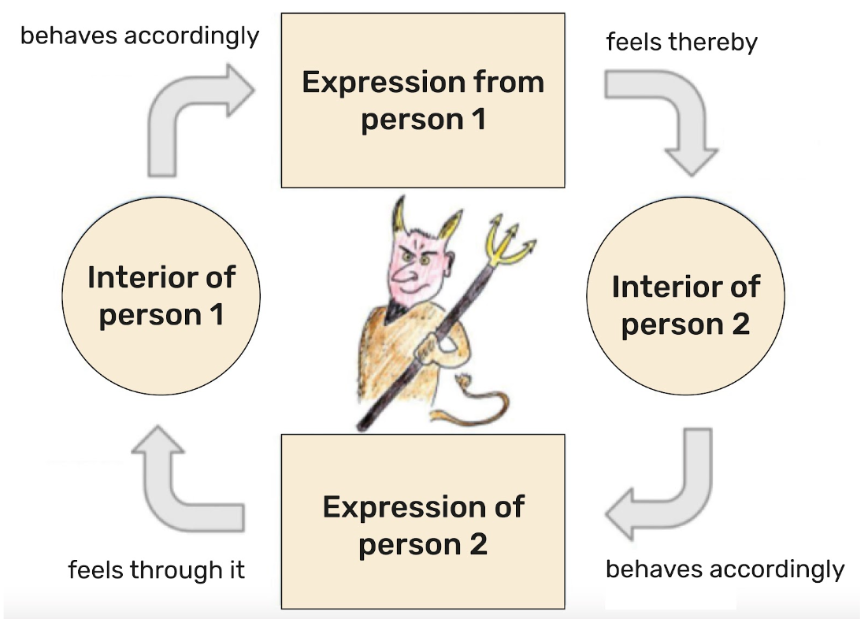
Breaking vicious cycles

Slide 7
Breaking vicious cycles
Feedback is a loop of reaction
This goes wrong when 4 behaviors are exhibited
Criticism (no patience)
Contempt (no caring)
Defensiveness (no listening)
Stonewalling (no speaking)
To break these cycles we need to:
Be aware of the cycle
Regularly ask for feedback
Regularly listen
Be willing to change for the sake of the other

Slide 8
Christians should be receptive to feedback
Jesus replied, “Truly I tell you, the Son is not able to do anything on his own, but only what he sees the Father doing. For whatever the Father does, the Son likewise does these things. For the Father loves the Son and shows him everything he is doing, and he will show him greater works than these so that you will be amazed.
- John 5:19-20 CSB

Slide 9
Break and Reflection - 15 minutes
Where is an area you currently could use some feedback?
How could you go about getting it from others?
How are you at accepting and acting on feedback?

Slide 10
Reflection - 30 min.
What have you learned? What are you wondering about?

