Slide 1
Building Systems of Communication
Organizing & Streamlining Communication

Slide 2

Set Gears: Define processes
Who does what when?
Like interlocking gears - which part do I play?

Slide 3
Templates: Define the issues
Some things come up often enough you need a standard response or action to be taken
Common questions
Common tasks
Process descriptions
Theological positions
Values
Mission Statement
Donations
External Representation

Slide 4
Template: Define the solutions
What templates do we need?
Who is responsible for creating and maintaining them?
Where and how are these templates used and shared?

Slide 5
Case Study: Amazon Employees
Customer Obsessed
Take ownership
Invent and simplify
Be right, a lot
Learn and Be Curious
Hire and Develop the Best
Insist on Higher Standards
8. Think Big
9. Act quickly
10. Be Frugal
11. Earn Trust
12. Dive Deep
13. Have a Backbone
14. Deliver Results

Slide 6
Reflection
Do Amazon Employees know how to behave when they are at work?
Do your staff or volunteers know how they should behave at work?
Where do your processes need work?
Where are they good?

Slide 7
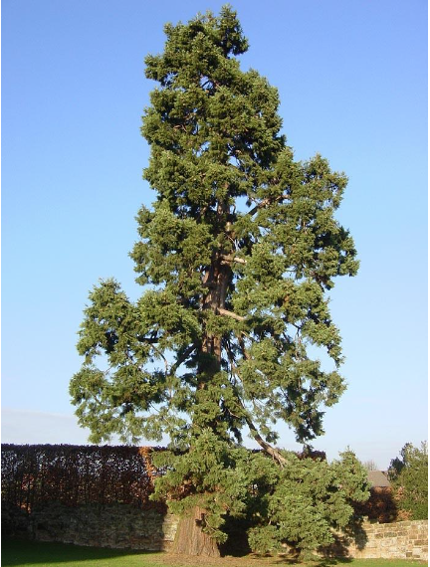
Channels of Communication
Think like a tree
Roots deliver water
Xylem and Phloem deliver nutrients
Leafs harness the power of the sun for energy
Everything moves according to a certain order - all parts work together
Successful communication leads to growth

Slide 8
Information: What and how?
Money
Who knows about it? Who makes decisions?
Is there freedom to innovate? What controls exist?
Innovation
Is there a culture of innovation?
How do you decide whether to follow an idea or not?
Where are successes celebrated?
How do you deal with failure as a group?
Personal or Confidential Information
GDPR - know the rules
What can be shared? What cannot be shared?
What should and should not? Who decides?

Slide 9
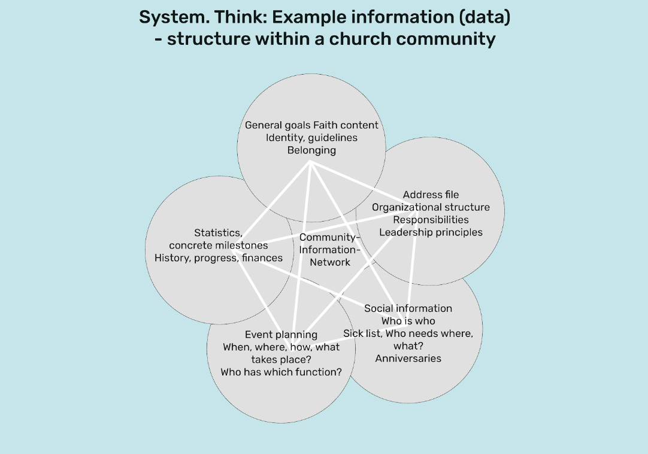

Slide 10
Summary: Creating Systems
Define Processes: who does what when? Set the gears
Create Templates
Define the issues
Define the solutions
Who makes them and maintains them?
Create Channels for informational flow
Think like a tree
Consider innovation, money and sensitive information

Slide 11
Break - 15 minutes
Reflection: How are each of the following doing in your organization currently? What could be improved?
Systems: Do people know who does what when?
Templates: Have you identified common problems and solutions?
Channels: Do you have a clear flow of information in your organization?

Slide 12
Group time: Gather into your churches
You task is to develop a system of communication with clear:
Processes: Who does what when?
Templates: Common problems and solutions
Channels for Informational Flow: What needs to be shared and how is it shared?
Particularly money, sensitive information, and innovation
Room 1: Upper Room Ministries
Room 2: Home Church
Room 3: Christ Family Church

Slide 13
15 Minute Break
Organizing & Streamlining Communication

